Slide 1


EXPORT PRECEDURES AND
DOCUMENTATION
A PAPER PRESENTATION BY
MR BABATUNDE FALEKE
THE REGIONAL COORDINATOR, SOUTH WEST
NIGERIAN EXPORT PROMOTION COUNCIL, LAGOS, AT THE
CHARTERED INSTITUTE OF PERSONNEL PRACTITIONERS’ CONSULTATIVE ASSOCIATION
(PPCA IKEJA) WORKSHOP ON JULY 5, 2017 AT
GUINNESS NIGERIA PLC, OFF OBA AKRAN AVENUE, IKEJA, LAGOS

Slide 2
OUTLINE
Introduction.
About NEPC
Export: Definition, benefits and Nigerian exportable products.
Export Procedures.
Export Documentation and Purposes.
Securing export order and contract negotiations.
Post order transactions, shipment and market access.
Bank transactions.
Repatriation of export proceeds.

Slide 3
INTRODUCTION
Nigeria is a great nation endowed with a lot of good quality natural mineral resources, agricultural produce and great human talents.
These resource however, needs to be properly harnessed to sustain the economy particularly in this present day of recession.
The NEPC therefore, a Federal government agency was established in 1976 and charged with the sole responsibility of promoting the development of non-oil exports and to diversify the nations economy through provision of technical assistance to export oriented industries, promotion of public private partnerships, organization of sensitization programs, capacity building, administration of post export incentives, offering advisory services, disseminating information on market trends and liaison with commodity associations with a view of identifying products for export development.

Slide 4
NEPC: VISION AND MISSION STATEMENT
Vision
To make the world a market place for Nigerian non-oil products.
Mission
To diversify the Nigerian economy by expanding and increasing non-oil exports for sustainable inclusive economic growth.

Slide 5
EXPORT: DEFINITION, BENEFITS AND EXPORTABLE PRODUCTS
Export is simply selling of goods and services to another country.
Export is product shift or expansion from domestic market to target customers at the international market
Export is one of the patterns of international business where activities are carried out across the national boundaries. This could be on regular basis or occasionally.

Slide 6
EXPORT: BENEFITS
To gain global market shares
To increase sales and profit levels
To enhance domestic competitiveness
To reap economies of scale
To replicate domestic success in another country.

Slide 7

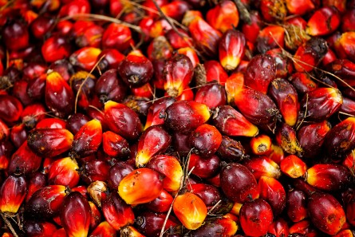




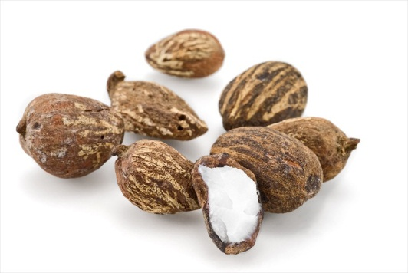






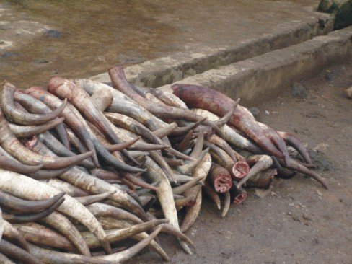

SOME EXPORTABLE PRODUCTS FROM
NIGERIA
FDPPRODUC

Slide 8
SOME EXPORTABLE PRODUCTS & SERVICES
FROM NIGERIA
PRODUCTS | PRODUCTS
Agricultural Commodities | Garment & Textiles
Soybeans, Cocoa, Palm Oil, Shrimps | Baby clothes
Cashew, Coffee, Tobacco, | Hand woven textiles – Aso Oke, Adire, Batik etc.
Cotton & Yarn, Ginger, | Handicrafts
Yam, Groundnut | Handwoven Textiles, paintings, Processed Leather
Solid Minerals | Beads, Pottery, Wood Carvings, Talking Drums,
Coal | Pharmaceuticals
Gold | Anti Maria
Manufactured goods | Antibiotics
Cocoa Powder | Services
Processed Leather | Movies, Music, African Cuisine
Rubber | Hair Dressing & other services

Slide 9
SOME EXPORTABLE PRODUCTS DESTINATIONS
S/N | DESTINATIONS | PRODUCTS
1 | USA | Ginger, sea foods, process food. Textiles and Garment, Sugar, Rubber, cocoa
2 | Mexico | soybeans
3 | Netherlands | Palm Oil, Cocoa
4 | Germany | Petrochemicals cocoa
5 | Turkey | Petrochemical cotton and Yarn
6 | Iran and Iraq | Rice, cocoa
7 | China | Soybeans, Sugar, Cotton and Yarn.
8 | London, Ethiopia | Music
9 | London,Ethiopia | Music & other services
10 | Africa | Confectionaries Plastic, Bathroom slippers, biscuits ,milk products, pharmaceuticals
11 | Bamgladesh | Cotton Yarn
12 | Italy | Sugar and processed leather

Slide 10
LIST OF PROHIBITED ITEMS FOR EXPORT
S/N | ITEM
1. | TIMBER (ROUGH OR SAWN)
2. | RAW HIDES AND SKIN INCLUDING WET BLUE AND ALL UNFINISHED LEATHER
3. | MAIZE
4. | SCRAP METAL
5. | UNPROCESSED RUBBER LATEX AND RUBBERLUMPS
6. | ARTIFACTS AND ANTIQUITIES
7. | WILD LIFE ANIMALS CLASSIFIED AS ENDANGERED SPECIES AND THEIR PRODUCTS E.G CROCODILES, ELEPHANT, LIZARD, EAGLE, MONKEY, ZEBRA, LION ETC.

Slide 11
SOME EXPORTABLE PRODUCTS FROM NIGERIA INTO THE US
UNDER THE AFRICAN GROWTH AND OPPORTUNITY ACT (AGOA)
AGOA is a Statutory Trade preference Law by the United States government which provides duty and quota free incentives for the entry of some products from the 39 eligible Sub Saharan African (SSA) countries. Nigeria secured AGOA eligibility in year 2000.
There are 4,600 of these products which qualify for elimination of tariffs under the Generalised System of Preference (GSP) of the U.S while 2000 products are now included under AGOA making a total of 6,400 eligible products. For ease of understanding, these products have been classified into 6 categories viz: Shea, Cashew, Specialty Foods, Textiles & Apparel, Handicraft, Sustainable Fish and Sea Food, Footwear & leather products.
The comprehensive list of the AGOA eligible products, sector specific and latest information on AGOA can be viewed on-line at http://trade.gov/agoa.
and to determine if your product is eligible for duty free treatment, please visit http://hts.usitc.gov/.
An exporter also needs to be guided by the checklist for exporting Non-textile and Textile goods under AGOA.

Slide 12
CHECKLIST FOR EXPORTING INTO THE US UNDER THE
AFRICAN GROWTH AND OPPORTUNITY ACT (AGOA)

Slide 13
EXPORT PROCEDURES
Export Procedure is a formal process in the conduct of international trade.
Getting Started
An Exporter needs to conduct a feasibility study and consider the availability of the of the following before venturing to register as an exporter:
    Production resources
    Financial resources
    Human resources
    Marketing resources
Development of Export Business Plan, ‘PEST’ analysis

Slide 14
EXPORT PROCEDURES (CONTINUATION)
BASIC GUIDELINES AND SEQUENCE TO FORMAL EXPORT TRADE
Who Can Register As An Exporter With The NEPC
Limited Liability Company
Cooperative Society
Government/Non Government Organisations
A potential exporter could register on-line by scanning and uploading the required documents into the Councils website: www.nepc.gov.ng and carefully following the step by step instructions.
Financial Requirements
  - For certificate only N13,500
  - For certificate with profiling N36,000.00
  - For renewal of certificate N7,500.00
  - For re-validation of certificate N12,500.00
  - For lost/mutilated certificate N12,500.00
  Payment could be done online with debit card or preferably with any Zenith Bank Branch in Nigeria. Once evidence of payment is presented at any NEPC office and the original copies of documents are sighted, certificate will be issued within 3-4 days.

Slide 15
REGISTRATION AS AN EXPORTER (DOCUMENTS REQUIRED)
re
Document Requirements For Registration as an Exporter
  For Limited Liability Company
  Certificate of Incorporation
  Certified True Copy of Form C07
  Certified True Copy of Memorandum and Articles of Association
  For Cooperative Society
  Certificate of Registration with the State Ministry of Commerce/Federal Development Authority
  Cooperative Bye-Law
  For Government/Non Government organisations
  Certificate of Registration by the corporate Affairs
  Articles of Association
  Laws establishing the Agency

Slide 16
EXPORT PROCEDURES (GENERATING EXPORT ORDER)
tewksk
Basic rules in Export Trade Contract and Negotiations
  Effective Communication:
    - All human activities revolve around communication.
    Communication stimulates interest leading to sustainable export trade relationship.
    It must be courteous, detailed. Written with profession expressions
  Proper understanding of the (11) International Commercial Terms (Incoterms) to ensure that consideration in the contract offer letter
  is sufficient.
  Initiating Export Trade Offer. which includes
    Detailed company profile,
    Name of product, nature of product, product contents.
    Price and discounts must be well stated
    Terms of payment either in Advance payment, confirmed Letter of credit etc.
    Delivery terms (time, port of discharge, transportation and Sundary responsibilities
    Annual production capacity
    Name of contact person and corporate referees – Banks, Chamber of Commerce, NEPC.
Packaging
  Packaging of products must be at its best to meet the buyers needs - quality & specification
  Agricultural Produce can either be packaged in boxes, bags, loose export etc. i.e. box primary, secondary or tertiary form
  Manufactured Products should either be in primary secondary or tertiary forms.
EXPORT PROCEDURES (CONTINUATION)

Slide 17
EXPORT PROCEDURES (GENERATING EXPORT ORDER)
tewksk
Export Market Linkage
  Participation in International Trade Fairs/Exhibitions/Shows (local and International)
  Trade Missions which occur when group of people from a particular country meet their counterparts to find ways of exploring and entering foreign markets
  Contact Promotion/Buyer seller meets when producers/manufacturers of a particular product in same industry arrange to meet their foreign buyers to transact business.
  B2B sites on-line – www.tradinglot.com, alibaba.com, globalbuyersonline.com, globalresourceonline.com, tradekey.com, tradeford.com, germanybusinesshub.com, b2bbyt.com, globaltrade.net, worldbid.com, globalsources.com, go4worldbusiness.com, itrademarket.com, unicomex.com.br, thaitrade.com, importexportplatform.com etc
  Trade Promotion Organisations – Jethro, CBC, International Trade Center (ITC)
  Trade Magazines e.g. Export Forum, Wade Trade
EXPORT PROCEDURES (CONTINUATION)

Slide 18
EXPORT PROCEDURES (CONTINUATION)
tewksk
Post Order Transactions
    Confirm acceptance of buyers order to be sure conformity with agreements
    Issue pro-forma invoice and find out if buyer requires other documents
    Check payment terms
    Register as an exporter with NEPC
    Certify the quality of your products with SON, NAFDAC, NAQCS, FDF, SGS, Cotechna, Swede Control, FDA, USDA, APHIS etc.
    Collect Non-oil Export Data Form from NEPC
    Open a Domiciliary account with a commercial bank, collect and fill Nigerian Export Proceeds Form (Form NXP)
    Obtain Clean Certificate of Inspection (CCI) from Carmine Assayer or Neroli Technologies Ltd after physical inspection of the products by either of the Pre-Shipment Inspection Agents.
    Obtain and complete Single Good Declaration (SGD Form) from Nigerian Customs Service
    Shipment – Identify Carrier, forward export product through a carrier (Clearing and Forwarding Agents) considering perishability and distance.
    - Repatriate Export Proceeds and collect evidence from the bank
EXPORT PROCEDURES (CONTINUATION)

Slide 19
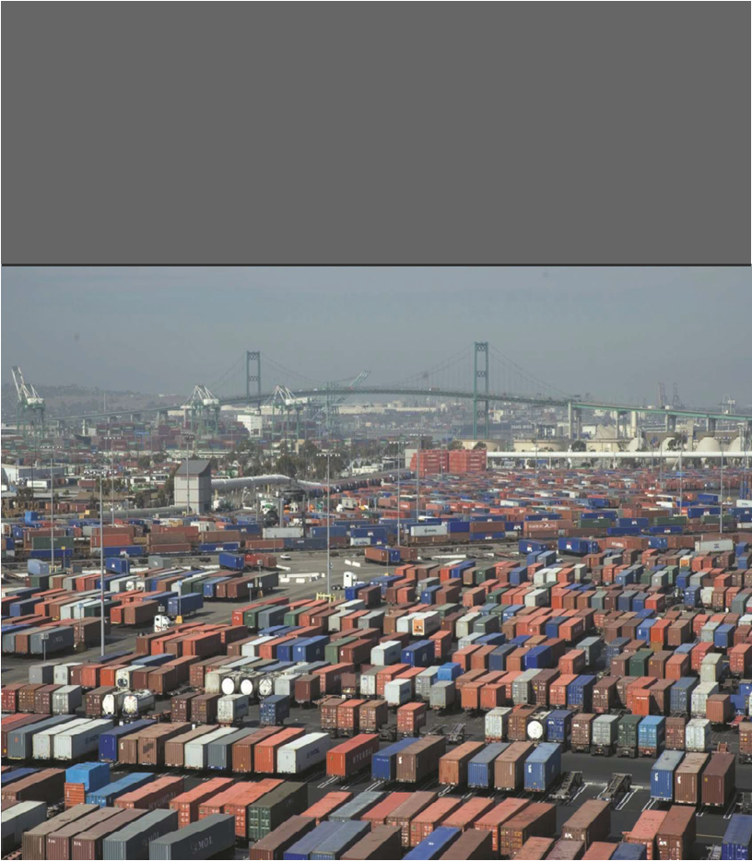
EXPORT DOCUMENTATION (SHIPMENT)

Slide 20
EXPORT DOCUMENTATION
There
Products Shipment must be accompanied with the following documents: Export /Commercial Documents such as: Proforma Invoice Commercial Invoice Certified Invoice Quality Documents such as: Certificate of Health & Sanitation Condition – NAFDAC. Certificate of quality and Fumigation- FPIS Phytosanitary Certificate – NAQCS Certificate of Quality – SON Clean Certificate of Inspection – Camine Assayer Transport Document Bill of Lading Airway Bill National Maritime Authority Agency Form Single Good Declaration form. | Financial Documents Nigerian Export Proceeds Form (NXP) – Commercial Bank Certificate of Insurance – Insurance Comany Tariff Concession Documents Form EUR 1 (For export into EU countries) GSP Form - NCS AGOA textile Certificate of Origin - NCS Certificate of Origin - NACCIMA Certificate of Commodity Export – FMCI Is a levy on Agricultural commodities Export Certificate - NEPC Packing List Letter of Clearance for Artifacts and Antiquities – National Museums and Monuments Letter of Clearance for Solid Minerals – Nigerian Minning Corporation. Cert

Slide 21
EXPORT DOCUMENTATION (PURPOSES)
There
To ensure that goods conform to specification To indicate Terms of Contract To show evidence of product origin To show evidence of delivery | Cert

Slide 22
MARKET ENTRY STRATEGY
Sourcing
Direct Exporting: The exporter selects the desired markets to penetrate, chooses the best channel of distribution for each market – agent, representatives, retailer or direct users through the exporter’s registered international business in a foreign country. This can facilitate foreign business connections required to sell the product.
Purchasing product for resale: NEXPOTRADE Houses Ltd is an example, the company has opened a Warehouse in Liberia
Piggy Marketing: Is an arrangement in which a manufacturer or service firm distribute a second firm’s product. Such service firm will have a contract with an overseas buyer to provide a wide range of products or services.
Cooperative Organisations/Export Department Cooperative: A group of people or association pulled their resources together in order to export together.

Slide 23
CONCLUSION
Think Export!
1. Do your market research
- It will enable you know there is a demand for your product.
2. Be the right producer
- Producing good quality products at competitive prices and plan to make volumes for export. Make a success right from home market.
3. Be export ready
- Meet international standards and export regionally and internationally
4. Make timely delivery
  Make proper planning and give sufficient lead time.
5. Support your shipment with genuine documents.

Slide 24
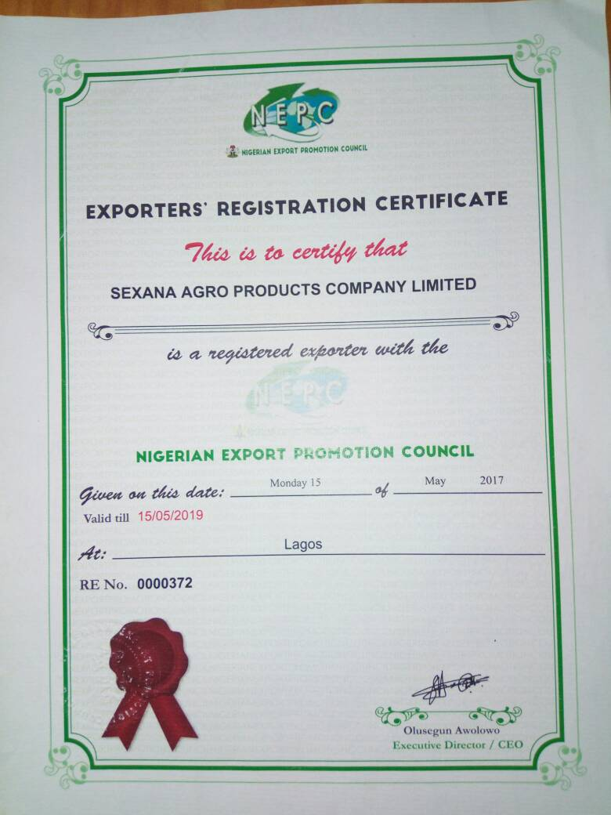
EXPORTER’S REGISTRATION CERTIFICATE

Slide 25
THANK YOU FOR YOUR ATTENTION!

