Slide 1
Gold Standard CS for HR Managers

Slide 3
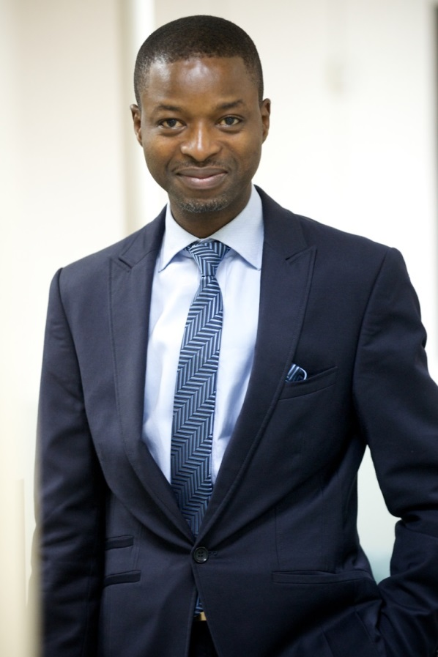
OLAKANMI AMOO-ONIDUNDU, Group HR Director, Troyka Holdings Ltd
Personnel Consultant/ Compensation Officer - International Institute of Tropical Agriculture (IITA); the Compensation Officer
Senior Information Officer in the Oyo State Civil Service.
A consummate motivational and conference speaker, mentor and life coach, Undergoing his Doctor of Business Administration (DBA) degree in Leadership from Walden University; Holds a Masters in Personnel Psychology Degree (M.P.P.) from the University of Ibadan & a B.Sc. from University of Ilorin. An alumnus of the Lagos Business School (LBS – SMP 30) and the Advanced Daystar Leadership Academy (DLA), also attended Cranfield University (UK) for his Leadership Competency Studies.
Olakanmi has been in General Human Capital Development, Personnel Management, Information, Media Relations and Journalism for about a quarter -century.
Chairman, 2015 Annual Lecture Luncheon, Ikeja PPCA of CIPM
Member, 2014-2016 The Professional Conduct & Ethics Committee, CIPM, Nigeria
Fellow, Institute of Strategic Management of Nigeria (FSM)
Member, Chartered Institute of Personnel Management of Nigeria (MCIPM),
Professional Practitioner of APCON (Advertising council of Nigeria) (ARP)
Member, Nigerian Institute of Management-Chartered (MNIM), Nigerian Institute for Training & Development (MNITAD).
Member, Society for Human Resource Management (SHRM)
Executive Board of the AAAN (Association of Advertising Agencies of Nigeria).
Former Assistant Secretary General, Oyo State Nigerian Union of Journalists (NUJ).
Olakanmi is a reverend gentleman, with passion for people development, general empowerment, mentoring & counselling.

Slide 4
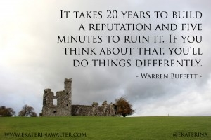

Slide 6
The Customer
Internal: Employees (FTE, STE, SNR, JNR, EXEC), Employer, Board members, Shareholders.
External: Prospective Employees, Community, Trade & Business Organizations, Unions, Suppliers, Government, Donors & Sponsors and even taxpayers.

Slide 7
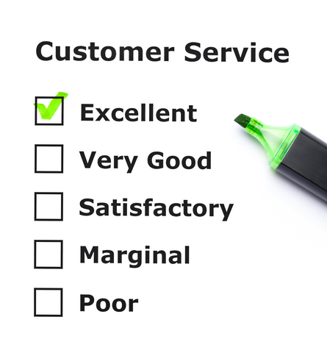
GOAL

Slide 8
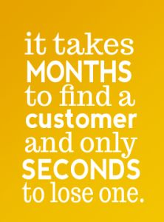

Slide 9
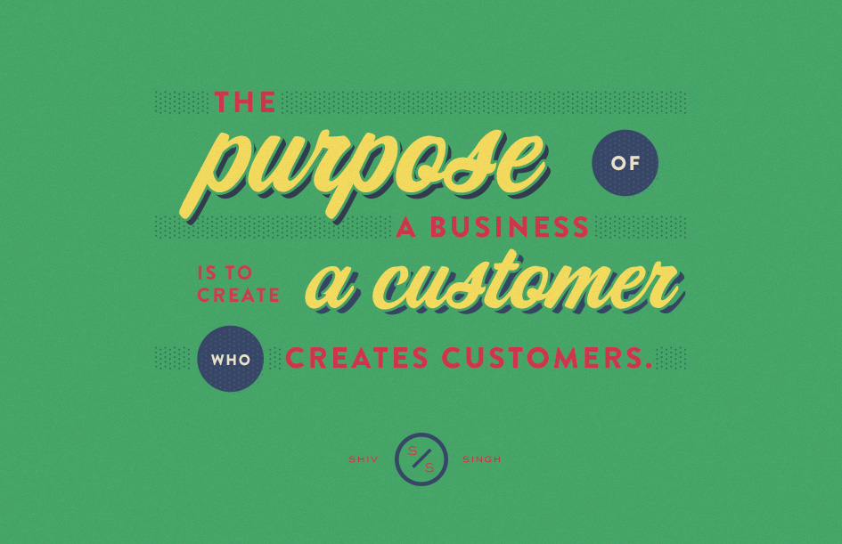

Slide 10
Types of Customers
Notes:
SALT, PEPPER, OIL, WATER, ETC.

Slide 12
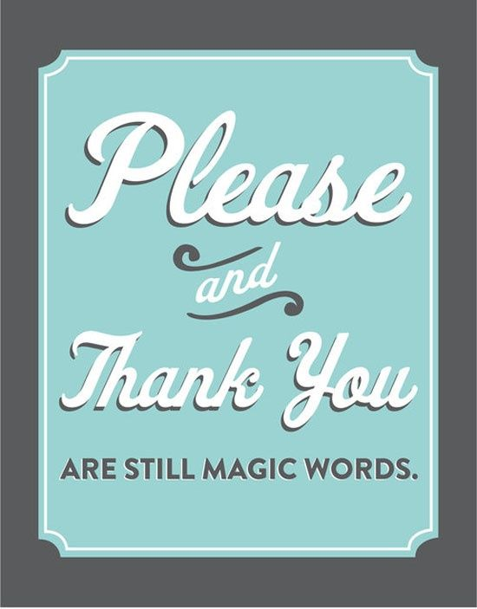

Slide 13
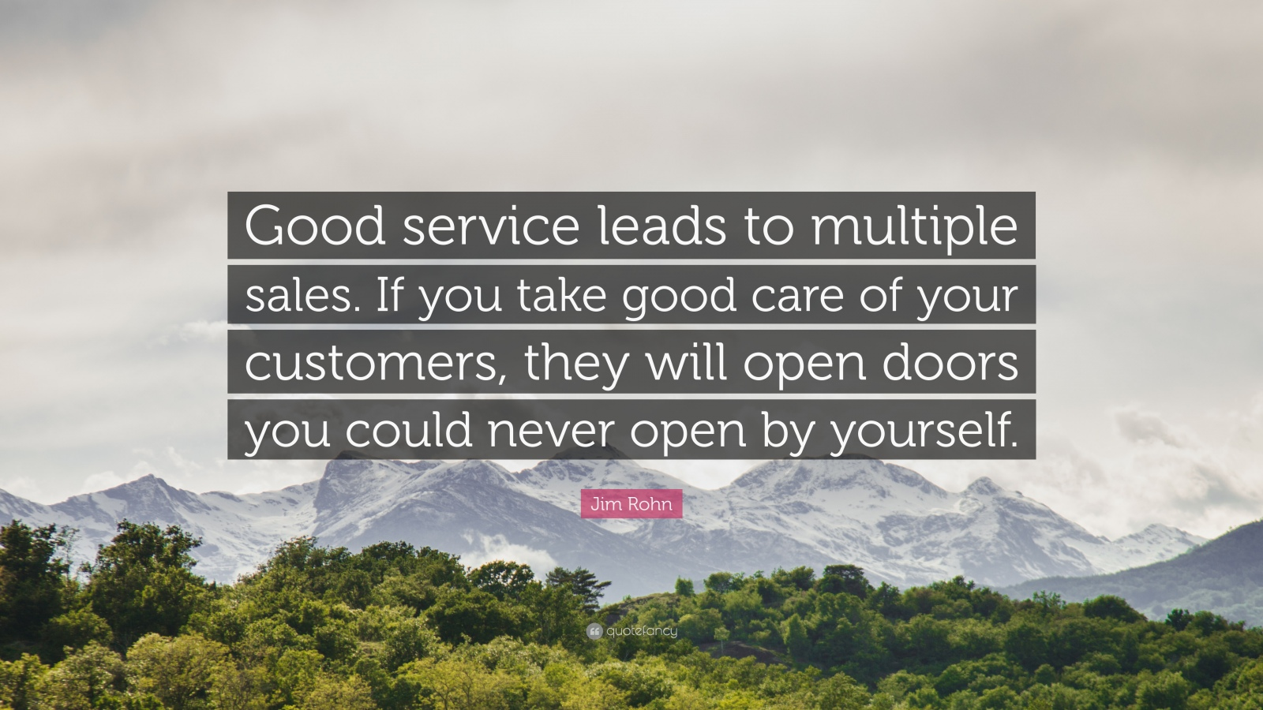

Slide 14
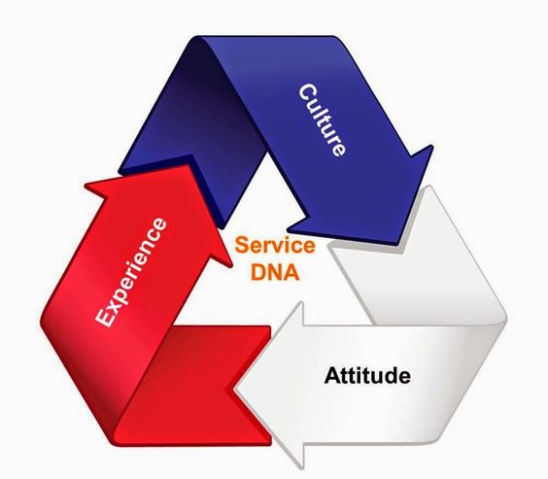
Customer Service
Series of activities designed to enhance customer (experiences &) satisfaction – Turban et al
Notes:
CS = YOU (Attitude) + ORGANISATION (Culture) + DELIVERY (Experience)

Slide 15
Core & Shell Relationship
Customer Service is a shell round the core of your Brand and quality.
CS is directionless & lacks strategy without the central core.
What exactly do you want your customers to experience and how (across all touch points in the value chain?)

Slide 16
Customer Service & Branding
Culture = Vision, Mission, Values, Systems , Structure & Strategies.
Culture = Brand
Brand = Perception & Emotional connection in the customer, from the tangible and intangible distinctions create by the entity.
CS is linked to Vision & Mission

Slide 17
CS MUST…
…Must be total, deliberate, conscious, to meet the gold standard.
…Is about building a brand on the emotive properties, beyond the rational.
More concern about HOW of a service, more than the what.
‘WHAT’ can be copied, but the spirit of the ‘HOW’ is difficult to imitate!

Slide 18
Coy XYZ CS Strategies
Passionate, Personal & Individual touch
Friendliness: Focus on Being More Welcoming (create a friendly, positive, welcoming presence by all)
Prompt Responsiveness (within the day!)
Hire Right People & Retain Engaged ones
Employee/Union-Management Meetings
Planned & Consistent Communication
Seek Feedback (M&E)
Compelling Visuals

Slide 19
Improving Coy XYZ CS Strategy
Active Listening
Admit mistakes you discovers even before customers do so.
Follow-up
Get Personal (Use social media & respond to queries promptly, interactive topics, post pictures, use local media, etc.)
Seek Feedbacks (CRM tools)
Be available
Cater to needs (Surveys)
Ethics & Etiquettes
Visibility of Organisational Vision, Mission & Values.
Notes:
Ownership Vs Employee Mentality
What more can I do? = Rob Story

Slide 20
Coy XYZ’s Expectations of HR Managers
Ownership Mentality
Initiative & Proactiveness
Innovation
What more can I do?
Next Level Performance at ALL TOUCH POINTS
Notes:
Ownership Vs Employee Mentality
What more can I do? = Rob Story

Slide 21
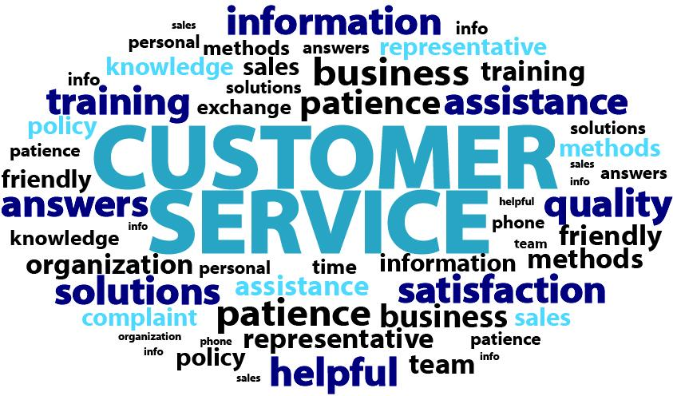

Slide 22
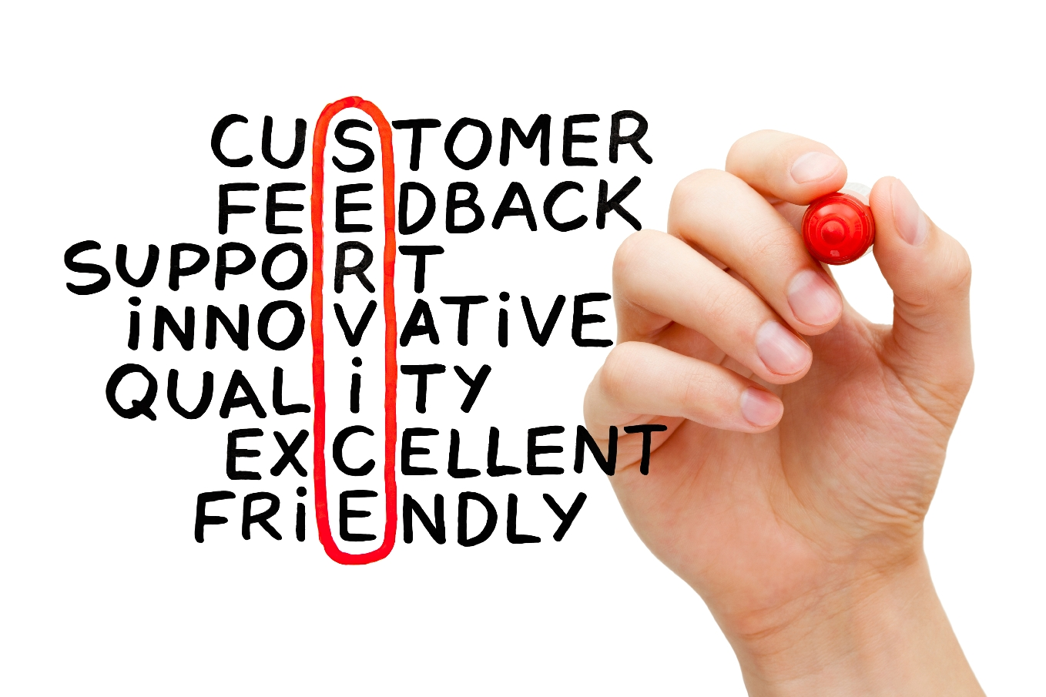

Slide 23
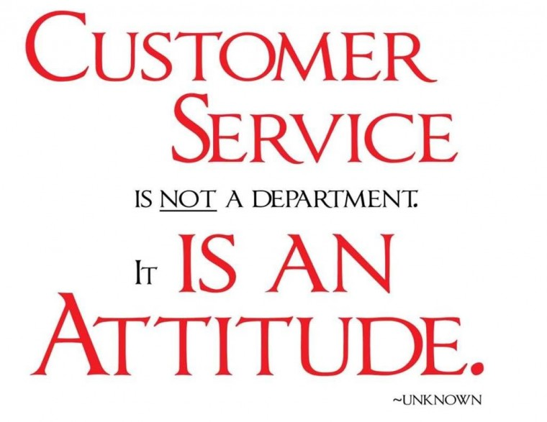

Slide 24
ATTITUDE

Slide 25
EXPECTATIONS

Slide 26
DISCUSS…

Slide 27
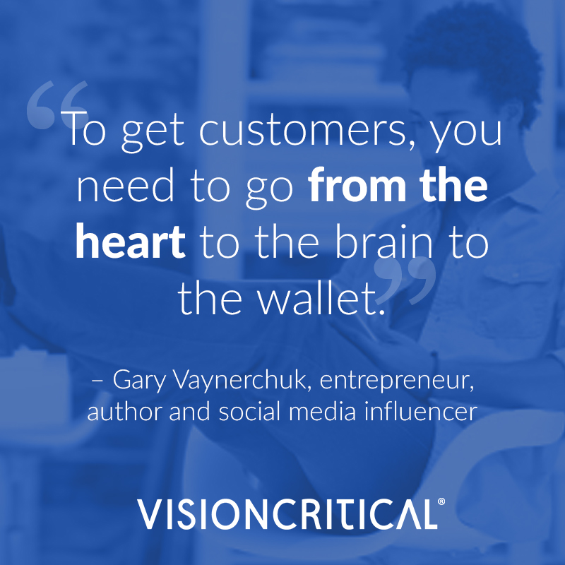

Slide 28
SAMPLES

Slide 30
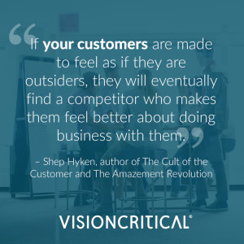

Slide 31
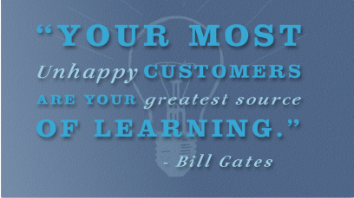

Slide 34
Delivered by

